Slide 1
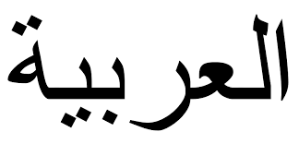
Welcome to Arabic II
Lesson 4

Slide 2
Mixed Review
Say in Arabic: My name is __________________

Slide 3
Arabic alphabets http://www.youtube.com/watch?v=8dQ3lizkjuE

Slide 4
What is your name:
Ask some one

Slide 5
How are you?
Address a male

Slide 6
Say: Good bye

Slide 7
Nice to meet you

Slide 8
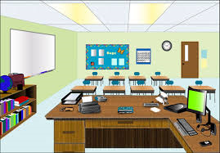
Familiar Objects at school
Window
Nafida:
Arabic:

Slide 9
This is a door
Baab
Arabic:

Slide 10
This is a Board
Loweh
Arabic:

Slide 11
This is a desk(student’s)
Thaawilat
Arabic:

Slide 12
This is a chair
Koursee
Arabic:

Slide 13
This is a paper
Waraka
Arabic:

Slide 14
This is a pen
Kalam
Arabic:

Slide 15
This is a ruler
Missthara
Arabic

Slide 16
This is a calculator
Haassiba
Arabic:

Slide 17
I have an easel
Also known as “Alhamel”

Slide 18
The Letter Alif Maqsura
ى

Slide 19
The ltters alif Maqsura is a variant of the regular alif. It is pronounced the same as alif (A), but it is restricted to a final word position. Just like a ya minus the two dots below it.
Independent: _____________
Final Connected: _______

Slide 20
ع+ل+ى= ف+د+و+ى= ل+ي+ل+ى=
Examples

Slide 21
ر+ع+ى= ي+ش+ت+ر+ى=

Slide 22
Listen to each word dictated to you and write it down.

Slide 23
Today is:

Slide 24
Home work: Connect the following letters to form words including vowels

Slide 25
Name: ________ Date: د+َ+ر+ّ+ا+ج+َ+ة= ا+ء+بْ+ت+ِ+س+َ+ا+م= خ+َ+ب+ب+ا+ز= م+َ+س+ا+ء= غ+ُ+ر+ْ+ف+َ+ة= ا+ء+ه+ْ+ل+ا+ً=

